Slide 1

Oil and gas asset management
By: Jimmy Barnett

Slide 2
Inspiration
The idea from this project came from the increasing relevance of the Digital Oil Field in Oil and Gas supply chains
Current Digital Oil Field initiatives incorporate multiple levels of supply chain optimization solutions
There is a push towards real-time asset management
The application’s purpose is to route the product between assets like refineries, pipelines, storage locations or processing plants

Slide 3

Structure of webmap
Asset Database
Server
Cleans, Maps, and Buffers Data (when needed)
Query-able Webmap with intuitive UI

Slide 4
Materials and data
The data was collected mainly from EIA database online, 2019
In addition, large amounts of data were collected from Texas Railroad Commission
The EIA data had to be processed and clipped to only include Texas using ArcMap
ArcMap, ArcGIS Online servers, Arc JS API and html coding were utilized in the creation of the webmap

Slide 5
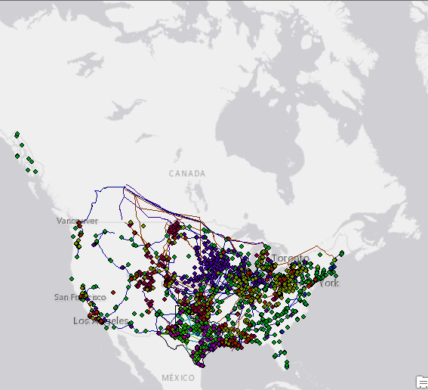
Us data had to be cut down, it contained too much information

Slide 6
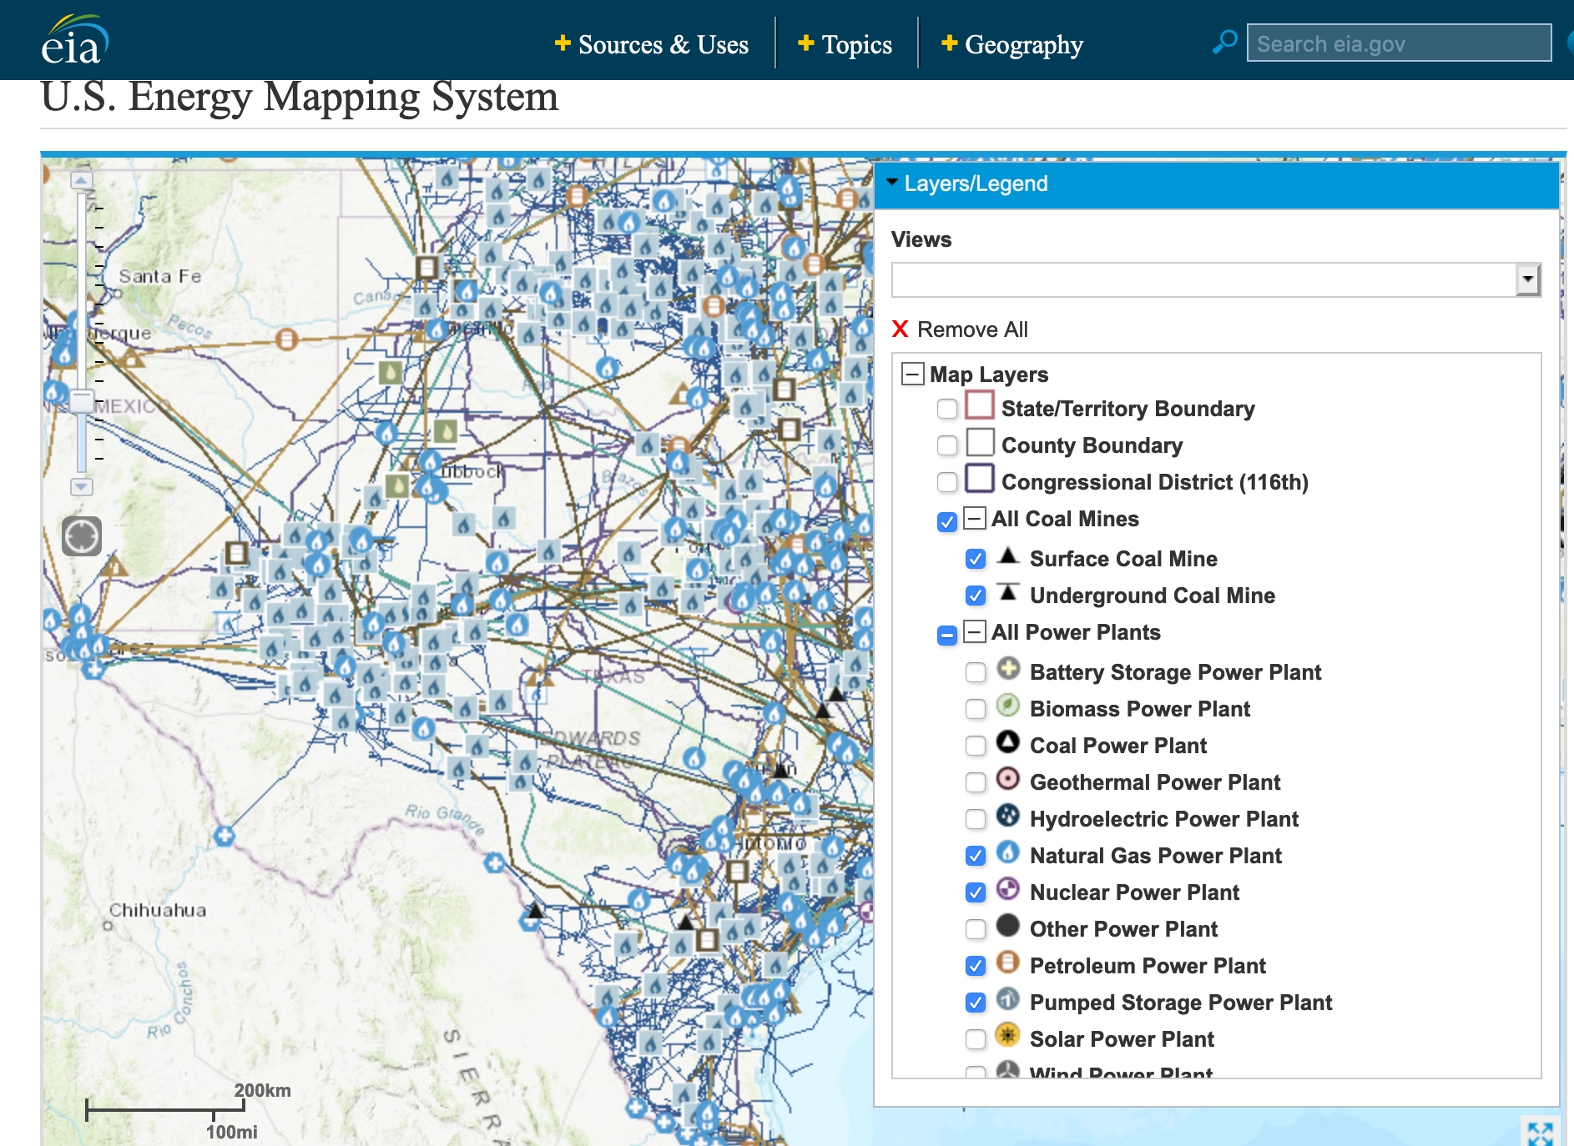
EIA Energy Mapping system data

Slide 7

Differences in execution and proposal
After trying multiple options for processing and APIs for analysis, ArcGIS ended up having nearly everything needed
ArcGIS routing, hosting and developer services helped create the precise functionality needed without any buffer analysis necessary
ArcGIS was utilized for cleaning, preparing, hosting and analyzing the data

Slide 8

Arcgis routing capabilities
Due to the advanced ArcGIS Routing and Network Analytics Services, a manual buffer analysis or routing using Google APIs was not necessary
The API can quickly route products of Oil and Natural Gas between important supply chain locations
Provides intuitive mapping and direction information between locations

Slide 9
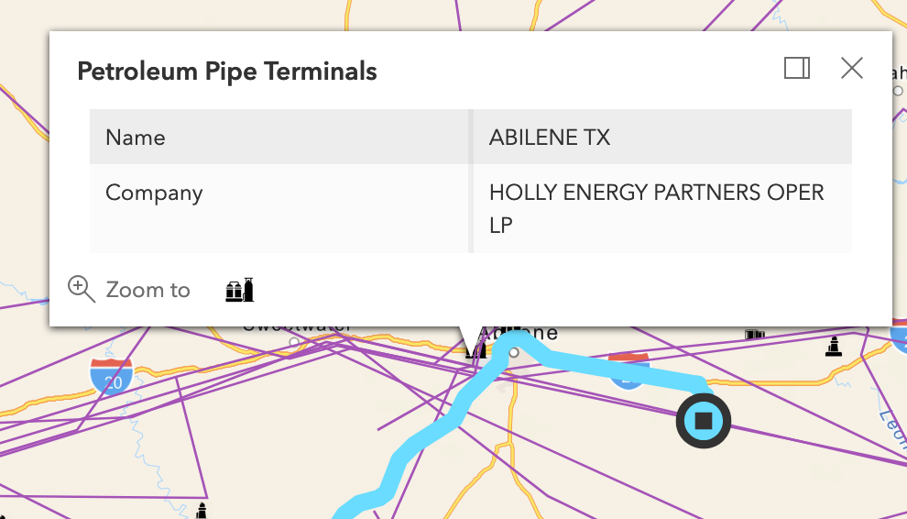
Completed web map
The final product, utilizing ESRI Javascript API contains the locations and types of assets across the state of Texas
It contains a routing window at the top right of the screen to choose two locations which to route between
Each asset type has a different icon and popup describing the asset

Slide 10
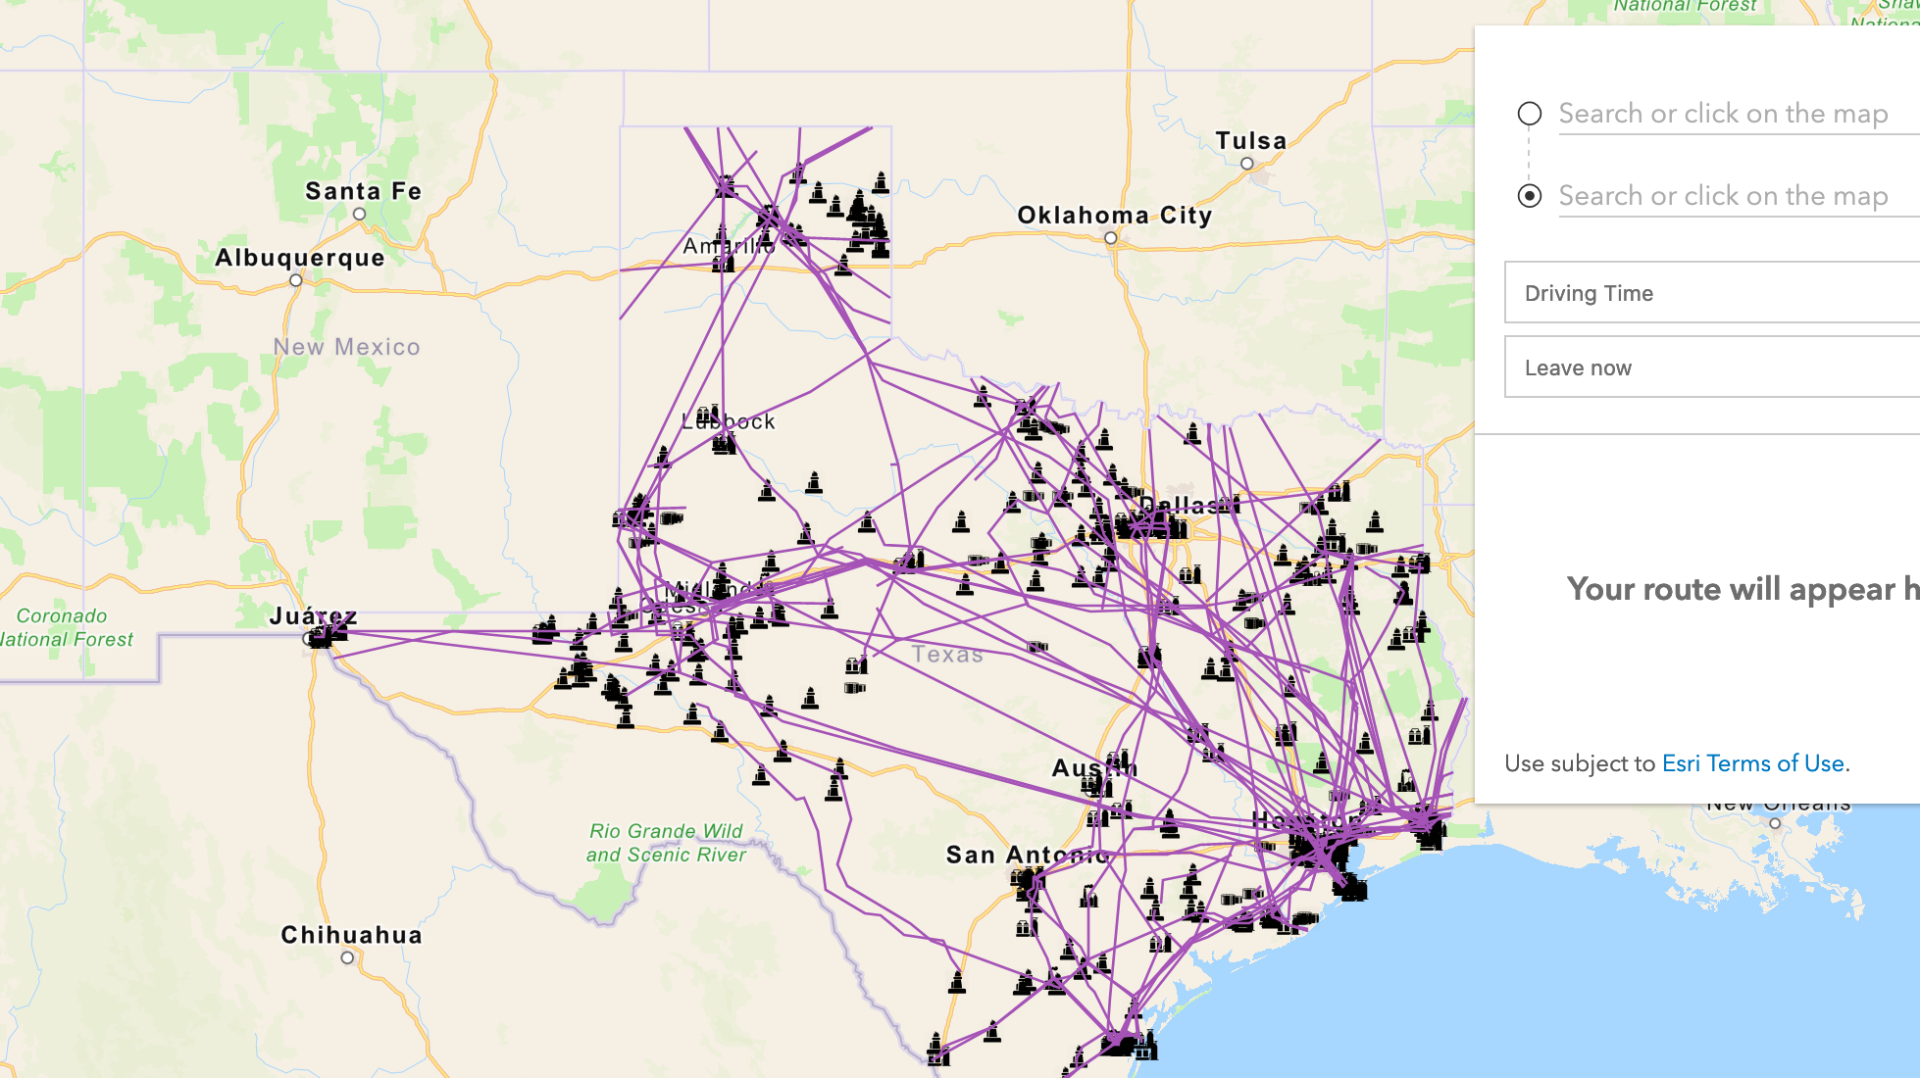
Final application

Slide 11
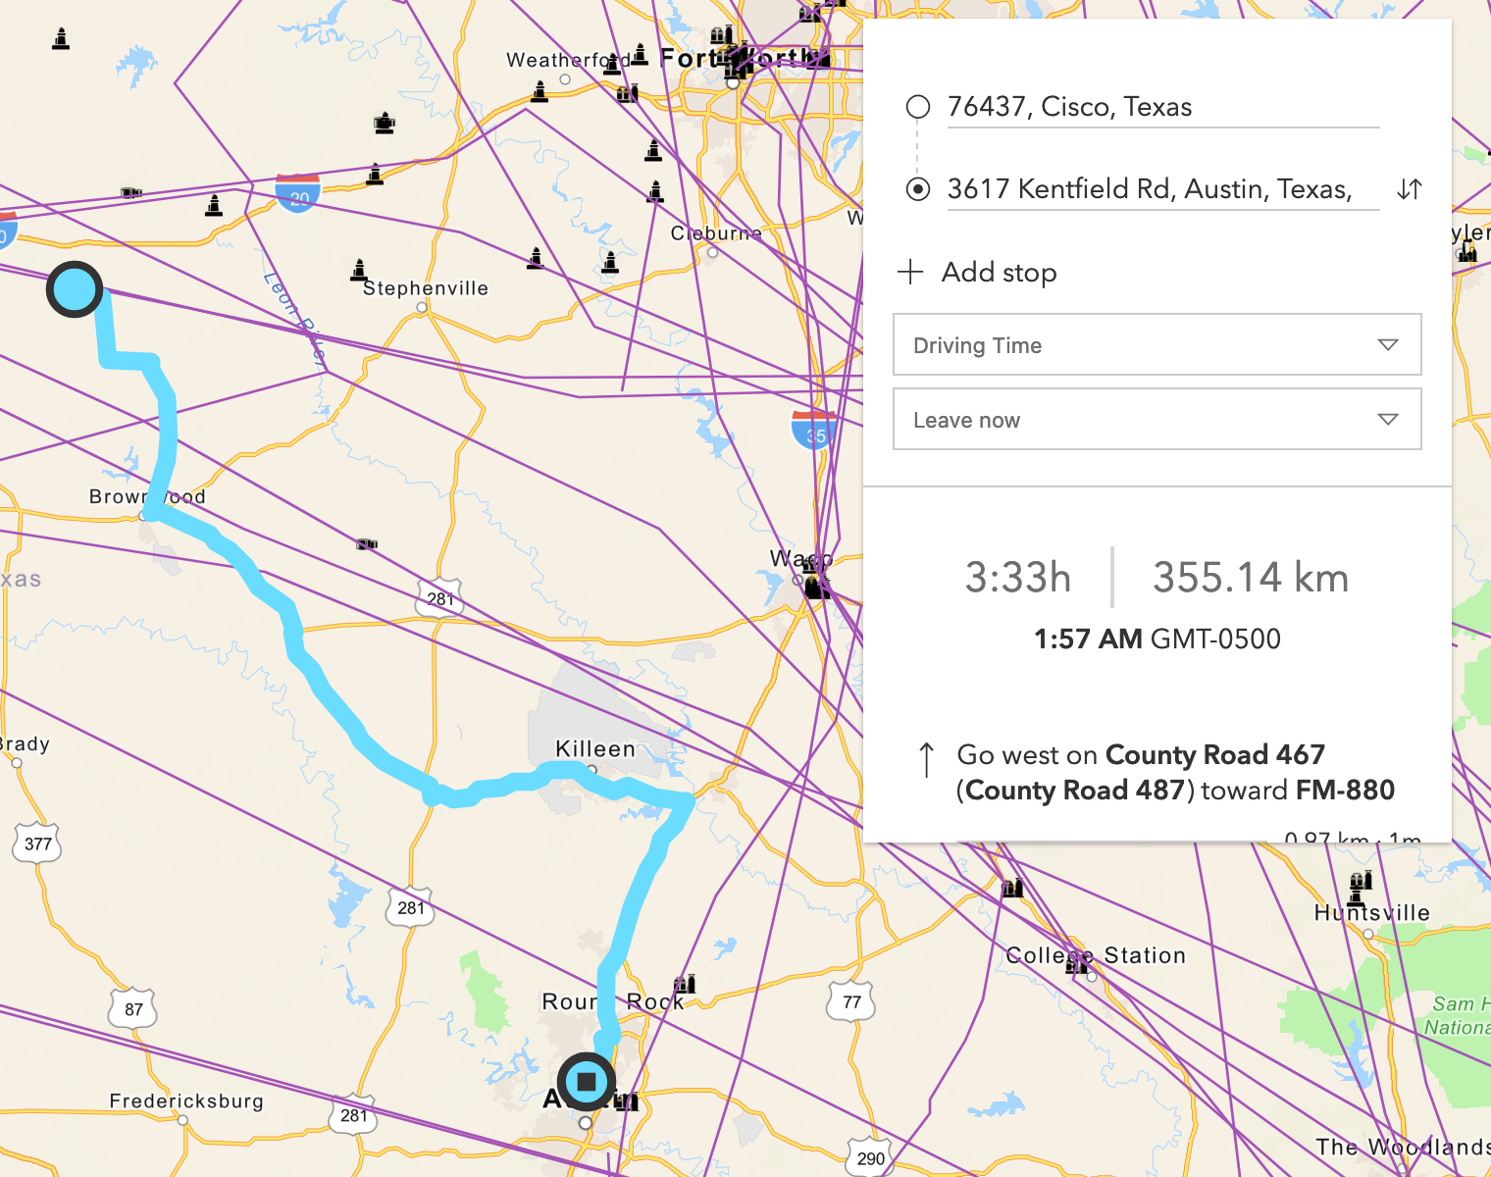
routing
Routing, handled by ESRI, was one of the most exciting parts of the map
The intuitive routing on the streets basemap with times, distances and between selectable locations is what pulled the map together
Can be done between selected assets as shown here

Slide 12
challenges
Some challenges that occurred stemmed from the sheer size of the data collected.
The amount of Oil and Gas assets made it nearly impossible to host each layer and maintain a usable runtime of the application
Over 1000 files of data were downloaded and could not be totally rendered on the map, so despite the fact that I have all of the data, it was not all utilized
Time - with more time I have no doubt that a good solution could be found for this glut of data, however without time processing each layer file would be temporally prohibited
The scripting of automatic FTP download ran into issues as well not being able to pull files, and had to be scrapped for time

Slide 13
solutions
If given more time to process and find large hosting solutions, I have no doubt that it all could have been utilized
The interesting thing about the Arc API is that data can be added relatively easily in two function formats which can be tweaked for each dataset quickly
Should this data be processed in the future, it can be added to the map with no problems of functionality and minimal style tweaks
In addition, code cleanup for runtime optimization could be utilized, however performance is currently acceptable but if data is added it would most likely be necessary

Slide 14
references
Perrons, R. K., & Jensen, J. W. (2015). Data as an asset: What the oil and gas sector can learn from other industries about “Big Data.” Energy Policy, 81, 117–121. doi:10.1016/j.enpol.2015.02.020
Holland, C. P., Shaw, D. R., & Kawalek, P. (2005). BP’s multi-enterprise asset management system. Information and Software Technology, 47(15), 999–1007. doi:10.1016/j.infsof.2005.09.006
Shuen, A., Feiler, P. F., & Teece, D. J. (2014). Dynamic capabilities in the upstream oil and gas sector: Managing next generation competition. Energy Strategy Reviews, 3, 5–13. doi:10.1016/j.esr.2014.05.002
Gringarten, A. C. (1998). Evolution of Reservoir Management Techniques: From Independent Methods to an Integrated Methodology. Impact on Petroleum Engineering Curriculum, Graduate Teaching and Competitive Advantage of Oil Companies. SPE Asia Pacific Conference on Integrated Modelling for Asset Management. doi:10.2118/39713-ms
LEON, M., AHIAGA-DAGBUI, D., FLEMING, C. and LAING, R. 2017. Exploring visual asset management collaboration: learning from the oil and gas sector. In Chan, P.W. and Neilson, C.J. (eds.) Proceedings of the 33rd Association of Researchers in Construction Management (ARCOM) annual conference, 4-6 September 2017, Cambridge, UK. Manchester: ARCOM [online], pages 765-774. Available from: http://www.arcom.ac.uk/...d0c7cdfafec96acc7e9.pdf
Unneland, T., & Hauser, M. K. (2005, January 1). Real-Time Asset Management: From Vision to Engagement-An Operator&apos;s Experience. Society of Petroleum Engineers. doi:10.2118/96390-MS
Ossai CI: Advances in asset management techniques: an overview of corrosion mechanisms and mitigation strategies for oil and gas pipelines. ISRN Corro 2012, 570143.
“About Us.” Texas RRC, Apr. 2020, www.rrc.state.tx.us/about-us/resource-center/research/data-sets-available-for-download/.
“Weekly Petroleum Status Report - U.S. Energy Information Administration (EIA).” Weekly Petroleum Status Report - U.S. Energy Information Administration (EIA), Apr. 2020, www.eia.gov/petroleum/supply/weekly/.

